Slide 1
AI Tech Infographics
Here is where this template begins
This template has been created by Slidesgo

Slide 2
AI Tech Infographics
Venus
1
Venus is the second planet from the Sun
Mars
2
Mars is actually a very cold place
Mercury
3
It’s the closest planet to the Sun
This template has been created by Slidesgo

Slide 3
AI Tech Infographics
Venus
Neptune
Venus is the second planet from the Sun
Neptune is far away from Earth
Mars
Jupiter
Mars is actually a very cold place
Jupiter is the biggest planet of them all
Mercury
Saturn
It’s the closest planet to the Sun
It’s composed of hydrogen and helium
This template has been created by Slidesgo

Slide 4
AI Tech Infographics
Venus
Mercury
2
Venus is the second planet from the Sun
It’s the closest planet to the Sun
Mars
1
3
Mars is actually a very cold place
This template has been created by Slidesgo

Slide 5
AI Tech Infographics
AI learning development tracker
 | 08:00 | 09:00 | 10:00 | 11:00 | 12:00 | 13:00 | 14:00 | 15:00 | 16:00
Mercury
Venus
Mars
Jupiter
Jupiter is big
Saturn has rings
Neptune is a giant
This template has been created by Slidesgo

Slide 6
AI Tech Infographics
Mercury is the smallest planet in the Solar System
Mercury
Despite being red, Mars is actually a cold place
Mars
Neptune is quite far away from Earth
Neptune
This template has been created by Slidesgo

Slide 7
AI Tech Infographics
Mars
Phase 1
A
Mars is actually a very cold place
Venus is hot
AI Tech
Venus
Phase 2
B
Venus is the second planet from the Sun
Earth has life
Mercury
Phase 3
C
It’s the closest planet to the Sun
Jupiter is big
This template has been created by Slidesgo

Slide 8
AI Tech Infographics
1
2
3
4
5
6
Mercury
Venus
Mars
Jupiter
Saturn
Neptune
It’s the closest planet to
the Sun
Venus is the second planet from the Sun
Mars is actually a very cold place
Jupiter is the biggest planet of them all
It’s composed of hydrogen and helium
Neptune is
far away
from Earth
This template has been created by Slidesgo

Slide 9
AI Tech Infographics
Venus
1
Jupiter
Neptune is the farthest planet from the Sun and a gas giant
Jupiter is a gas giant and the biggest planet of them all
4
2
Mercury
Mars
Mercury is the smallest planet in the entire Solar System
Despite being red,
Mars is actually a
cold place
3
This template has been created by Slidesgo

Slide 10
AI Tech Infographics
1
Mercury
Mercury is the smallest planet in the Solar System
2
Mars
Despite being red, Mars is actually a cold place
3
Jupiter
Jupiter is a gas giant and the biggest planet of them all
This template has been created by Slidesgo

Slide 11
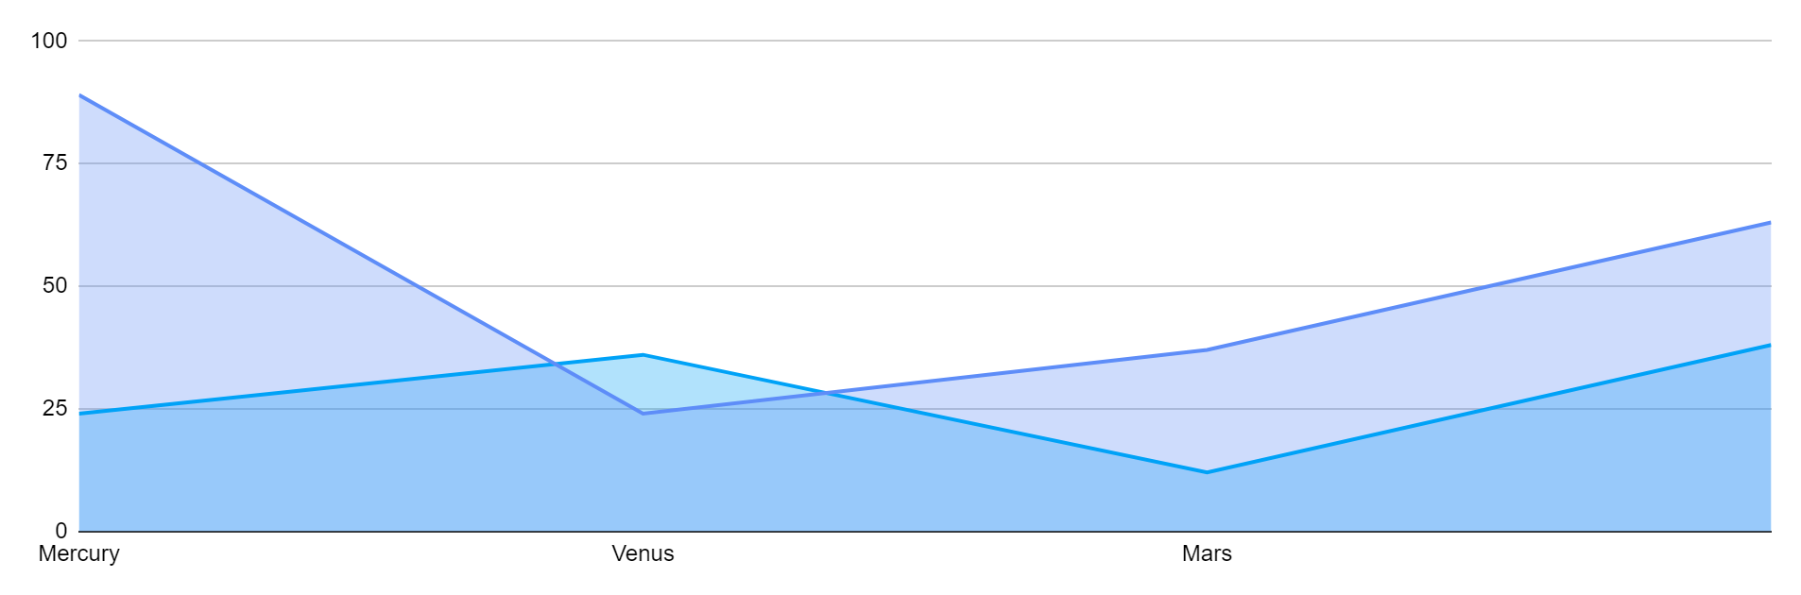
AI Tech Infographics
Milestone Schedule
Mars is actually a very cold place | xx,xxx | xx%
Saturn has several rings | xx,xxx | xx%
2XXX
2XXX
Venus is hot
Mars is cold
Follow the link in the graph to modify its data and then paste the new one here. For more info, click here
This template has been created by Slidesgo

Slide 12
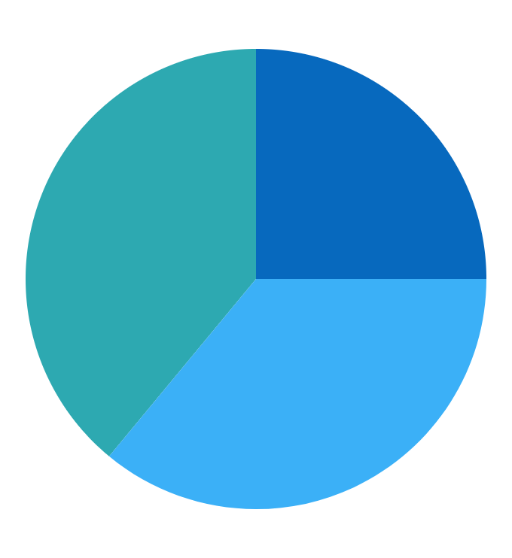
AI Tech Infographics
 | Q1 | Q2 | Q3 | Q4
Project 1
Project 2
Project 3
Concept
Execute
Evaluate
25 %
36%
39%
Earth
Jupiter
Saturn
Earth has life
Jupiter is big
Saturn has rings
Follow the link in the graph to modify its data and then paste the new one here. For more info, click here
This template has been created by Slidesgo

Slide 13
AI Tech Infographics
Venus
Neptune
Venus is the second planet from the Sun
Neptune is far away from Earth
Mars
Jupiter
Mars is actually a very cold place
Jupiter is the biggest planet of them all
Mercury
Saturn
It’s the closest planet to the Sun
It’s composed of hydrogen and helium
This template has been created by Slidesgo

Slide 14
AI Tech Infographics
Venus
Sun
Neptune
Mars
Venus is hot
The Sun is Star
Neptune is a giant
Mars is cold
A
AI System
B
Saturn
Jupiter
Earth
Pluto
Saturn has rings
Jupiter is big
Earth has life
Pluto is a dwarf
This template has been created by Slidesgo

Slide 15
AI Tech Infographics
2XXX
xx/xx
xx/xx
xx/xx
xx/xx
xx/xx
Saturn
Mars
Venus
Saturn
Jupiter
It's the closest planet to the Sun and the smallest one in the entire
Solar System
Despite being red, Mars is actually a cold place. It's full of iron
oxide dust
Venus has a beautiful name and is the second planet from the Sun
It’s a gas giant and has several rings. It's composed of hydrogen
and helium
It’s a the biggest planet in the
Solar System, named after a Roman god
This template has been created by Slidesgo

Slide 16
AI Tech Infographics
Jupiter
20%
It’s a the biggest planet in the Solar System, named after a Roman god
Saturn
80%
It's the closest planet to the Sun and the smallest one in the entire Solar System
This template has been created by Slidesgo

Slide 17
AI Tech Infographics
Venus
Venus is the second planet
from the Sun
Mercury
It’s the closest planet to
the Sun
 | Milestone schedule | Target | Risk | Result | Revenue
 | Venus | xx/xx/xx | High | 34% | 1,500$
 | Mercury | xx/xx/xx | Low | 67% | 2,750$
This template has been created by Slidesgo

Slide 18
AI Tech Infographics
Project 1
Project 2
65%
AI System
25%
Neptune is the farthest planet from the Sun
Despite being red, Mars is a cold place
Jupiter is a gas giant and the biggest planet
Mercury is the closest planet to the Sun
This template has been created by Slidesgo

Slide 19
AI Tech Infographics
Phase 1
Phase 3
Venus
Jupiter
Venus is the second planet from the Sun
Jupiter is the biggest planet of them all
2XXX
2XXX
2XXX
2XXX
Mars
Saturn
Mars is actually a very cold place
It’s composed of hydrogen and helium
Phase 2
Phase 3
This template has been created by Slidesgo

Slide 20
Icon pack
This template has been created by Slidesgo

Slide 21
Instructions for use (premium users)
As a Premium user, you can use this template without attributing Slidesgo
You are allowed to:
Modify this template
Use it for both personal and commercial projects
Share this template in an
editable format
Hide or delete the “Thanks” slide and the mention to Slidesgo in the credits
You are not allowed to:
Sublicense, sell or rent any of Slidesgo Content
Distribute Slidesgo Content unless it has been expressly authorized by Slidesgo
Use any of the elements that are part in a separated way
Register any of the elements as a trademark or logo in an intellectual property registry
For more information about editing slides, please read our FAQs or visit our blog

Slide 22
Infographics
You can add and edit some infographics to your presentation to present your data in a visual way.
Choose your favourite infographic and insert it in your presentation using Ctrl C + Ctrl V or Cmd C + Cmd V in Mac
Remember to choose the “Keep source formatting” option so that it keeps the design. For more info, please visit our blog
01
07
Select one of the parts and ungroup it by right-clicking and choosing “Ungroup”
Repeat the steps above with the other parts and when you’re done editing, copy the end result and paste it into your presentation
02
06
03
Change the color by clicking
on the paint bucket
05
Group the elements again by selecting them, right-clicking and choosing “Group”
Then resize the element by clicking and dragging one of the square-shaped points of its bounding box (the cursor should look like a double-headed arrow). Remember to hold Shift while dragging to keep the proportions
04

